Slide 1
Data Capstone Project
The Battle of Neighborhoods
By – Debdinnya Banerjee

Slide 2
Introduction
Build
Build a solution that will explore all neighborhoods of any particular city.
Suggest
Suggest best location of a city in terms of connectivity, housing prices, education for children, etc.
Purpose
For example purpose, we have considered the city of Scarborough in Toronto, Canada.

Slide 3
Target Audience
Due to flexible immigration rules, relocation to any part of the world has now become very common. If you want to move to a new city, this solution will help you to explore the new city and suggest the best possible neighborhood to reside offering the best connectivity, affordable housing prices, good education for children, proximity to hotels, malls, etc.

Slide 4
Data Description
Postal code and neighborhood details are extracted using the URL https://en.wikipedia.org/wiki/List_of_postal_codes_of_Canada:_M
Geocoder module in python will fetch latitude and longitude details of these neighborhoods.
Foursquare API is used as a location data provider of venues of interests in a particular location.

Slide 5
Methodology
K-means clustering approach has been used to find similar neighborhoods in a city.

Slide 6
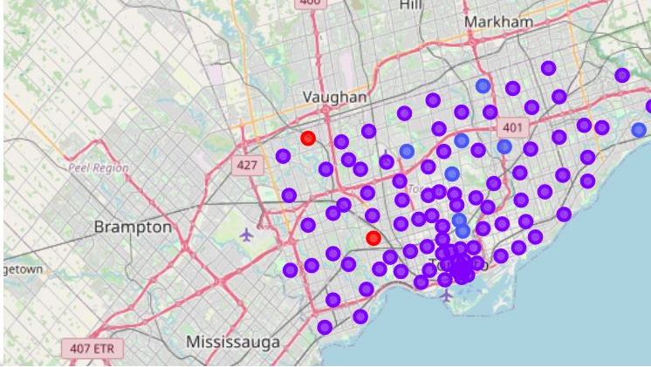
Results
Cluster Map of different neighborhoods in Scarborough

Slide 7
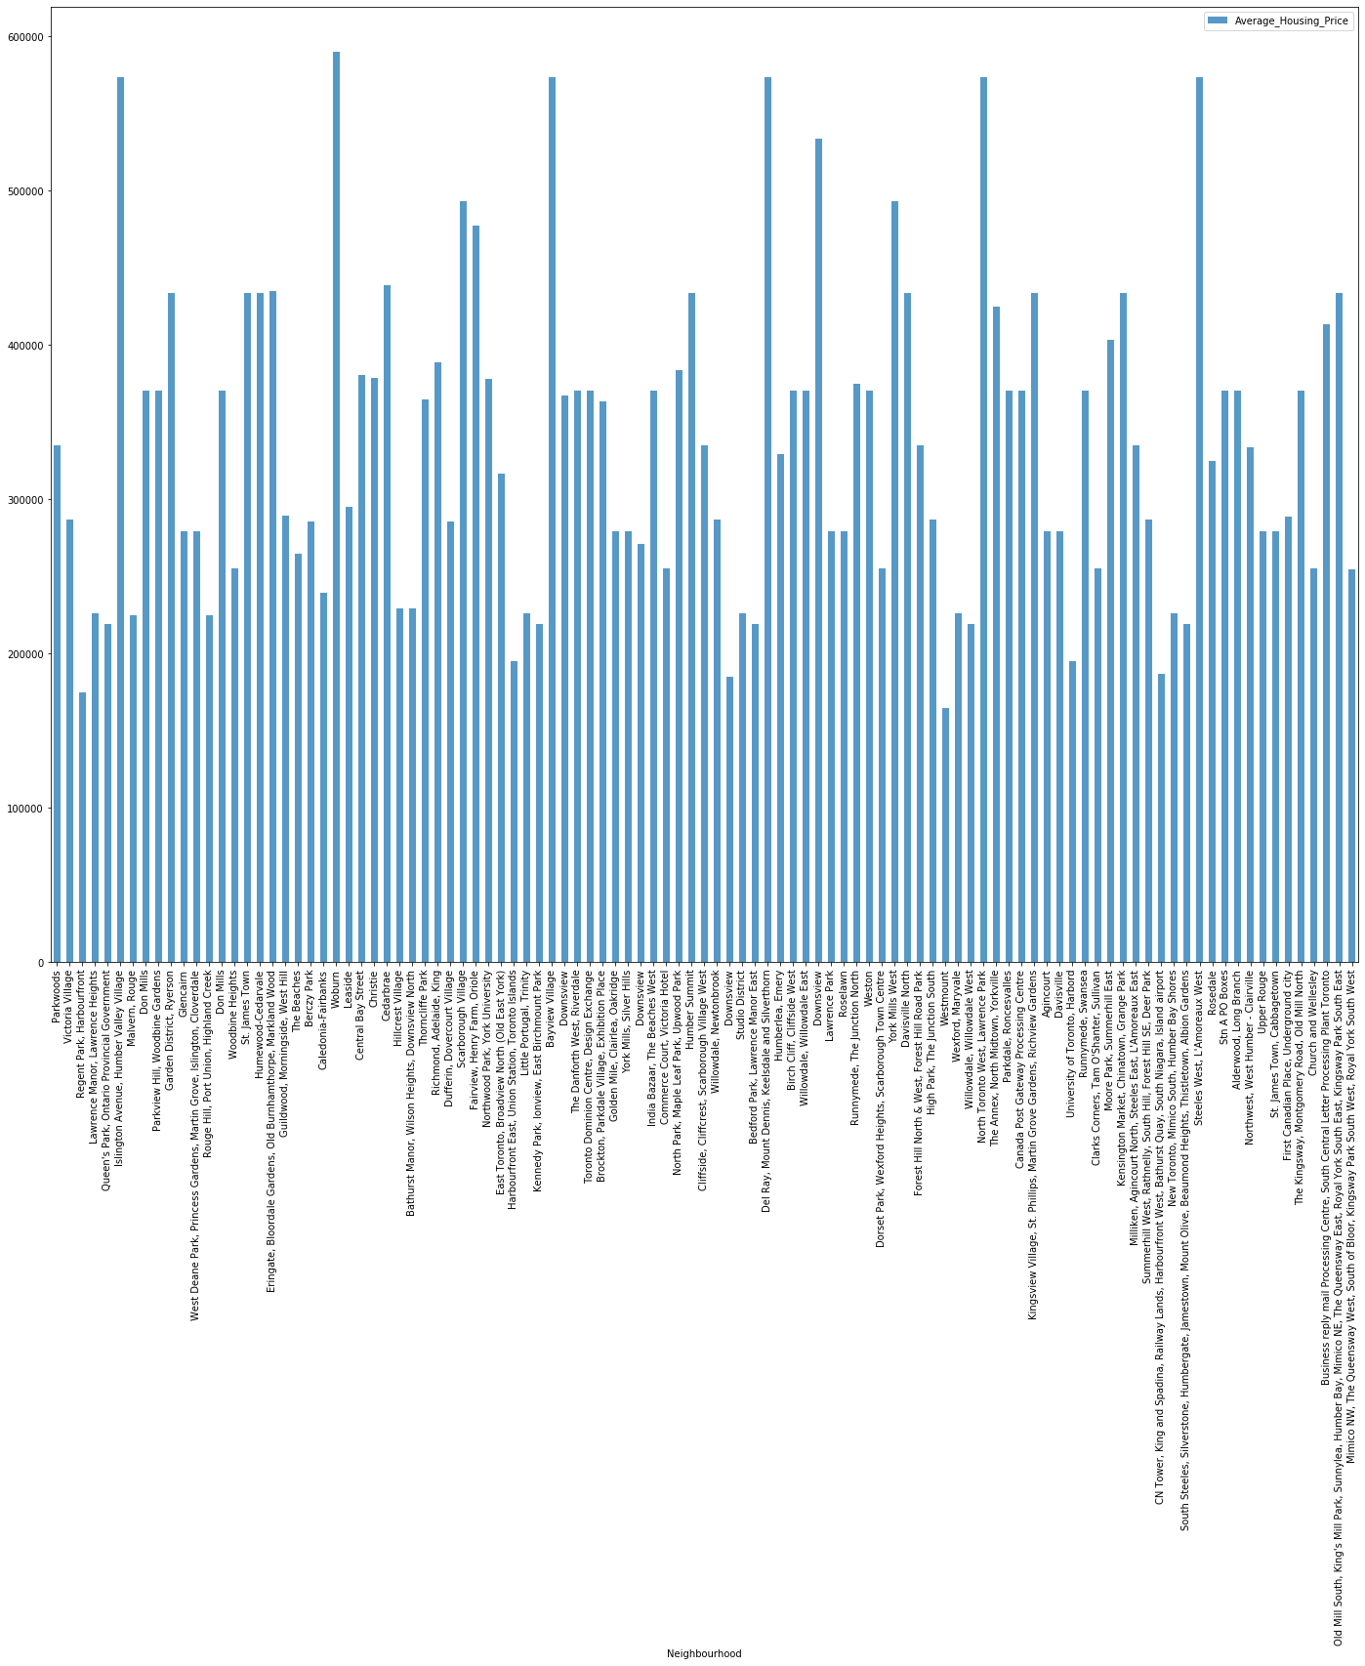
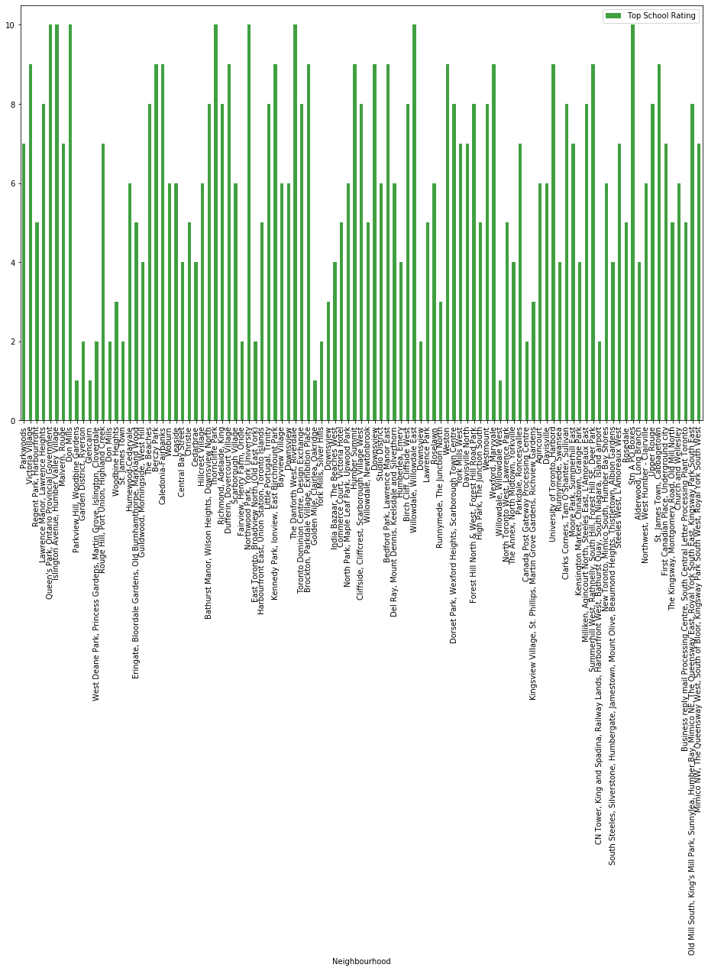
Results (continued)
Ratings of schools
Average Housing Prices

Slide 8
Discussion
Problem which tried to solve:
The major purpose of this project, is to suggest a better neighborhood in a new city for people who are relocating there.
Few things which are under scope of this project are:
Connectivity to the airport, bus stand, city center, markets and other daily needs things nearby.
Sorted list of house in terms of housing prices in a ascending or descending order
Sorted list of schools in terms of location, fees, rating and reviews

Slide 9
Python Libraries used
Numpy and Pandas
Folium
Scikit-learn
JSON
XML
Geocoder
Beautiful Soup and Requests
Matplotlib

Slide 10


